Slide 1
Web Services and APIs
IN712 Web3

Slide 2
Web Service or Web API?
The term API stands for Application Programming Interface. The term can be used to describe the features of a library, or how to interact with it.
Your favorite library may have "API Documentation" which documents which functions are available, how you call them, which arguments are required, etc.
However, these days, when people refer to an API they are most likely referring to an HTTP API, which can be a way of sharing application data over the internet.
For example, Twitter has an API that allows you to request tweets in a format that makes it easy to import into your own application.
This is the true power of HTTP APIs, being able to "mashup" data from multiple applications into your own hybrid application
The terms web services or web API definitely overlap
Both allow your web page to consume computation performed on another machine.
Some people use the terms interchangeably

Slide 3
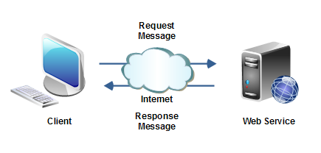
Web Services

Slide 4
Simplest Web Service
The very simplest web service consumption is just flicking an HTTP GET request in the shape of a URL with a query string
The returned data is usually in the form of JSON or XML data
The returned data needs to be appropriately processed by your application
Many of such web services require an authorisation key, which is included in the query string
Keys are usually free, and allow a limited number of searches per day

Slide 5
Example API calls
http://api.openweathermap.org/data/2.5/weather?q=London,uk&appid=f6b6fecf2c4292d8d19d201e57667588
http://api.openweathermap.org/data/2.5/weather?zip=9011,nz&appid=f6b6fecf2c4292d8d19d201e57667588
http://api.openweathermap.org/data/2.5/weather? lat=35&lon=139&appid=f6b6fecf2c4292d8d19d201e57667588
http://api.openweathermap.org/data/2.5/weather? id=2172797 &appid=f6b6fecf2c4292d8d19d201e57667588
http://api.openweathermap.org/data/2.5/weather?q=London,uk&appid=f6b6fecf2c4292d8d19d201e57667588&mode=xml
http://api.openweathermap.org/data/2.5/weather?q=London,uk&appid=f6b6fecf2c4292d8d19d201e57667588&mode=html

Slide 6
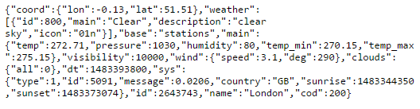
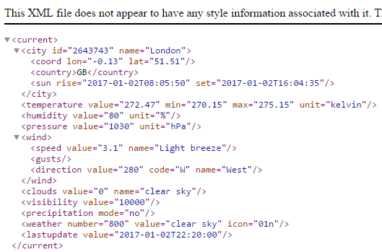
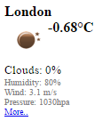
API responses
http://api.openweathermap.org/data/2.5/weather?q=London,uk&appid=f6b6fecf2c4292d8d19d201e57667588
http://api.openweathermap.org/data/2.5/weather?q=London,uk&appid=f6b6fecf2c4292d8d19d201e57667588&mode=xml
http://api.openweathermap.org/data/2.5/weather?q=London,uk&appid=f6b6fecf2c4292d8d19d201e57667588&mode=html

Slide 7
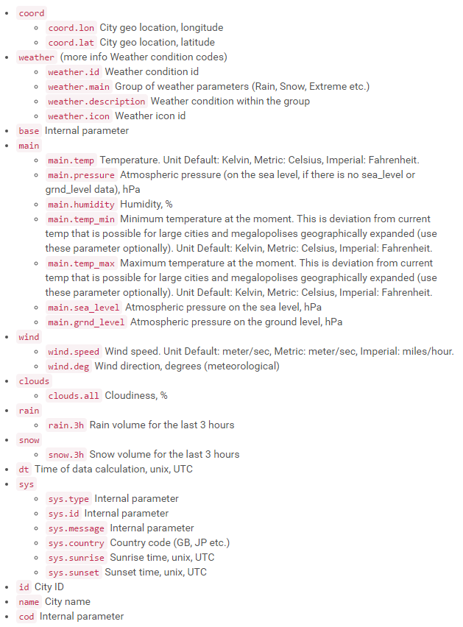
API response documentation
http://api.openweathermap.org/data/2.5/weather?q=London,uk&appid=f6b6fecf2c4292d8d19d201e57667588
{"coord":{"lon":-0.13,"lat":51.51},
"weather":[{"id":800,"main":"Clear","description":"clear sky","icon":"01n"}],
"base":"stations",
"main":{"temp":272.14,"pressure":1030,"humidity":93,"temp_min":271.15,"temp_max":274.15},
"visibility":10000,
"wind":{"speed":2.6,"deg":230},
"clouds":{"all":0},
"dt":1483399200,
"sys":{"type":1,"id":5091,"message":0.0105,"country":"GB","sunrise":1483344349,"sunset":1483373077},
"id":2643743,
"name":"London",
"cod":200}

Slide 8
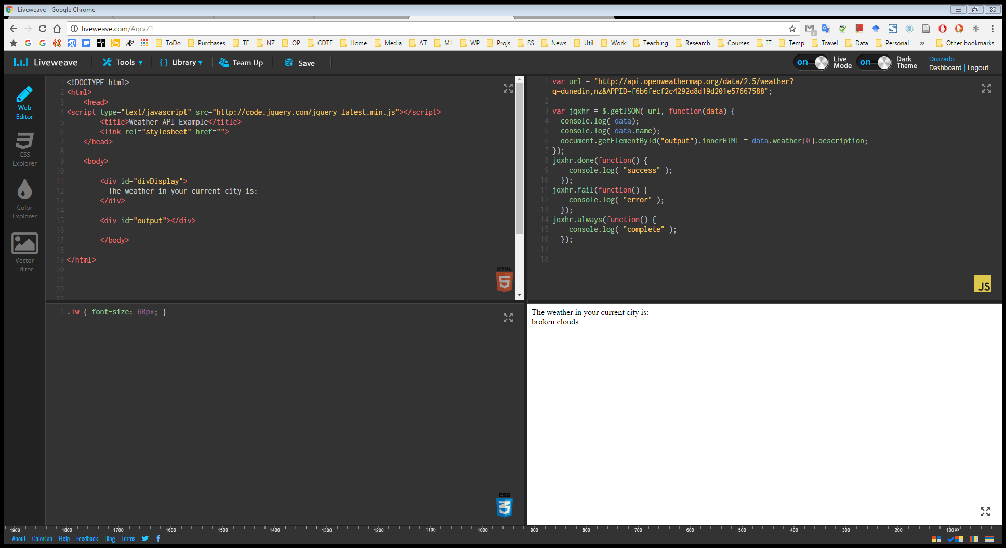
Demo
http://liveweave.com/AqrvZ1

Slide 9
More on Web APIs
Sometimes Web APIs display OO interfaces. They provide classes which expose methods.
When working with an API, you first load up a library, which contains the declaration of objects that you can use to consume the remote computation.
The objects will have methods to call and very specific interface requirements for those methods.
You need to spend time with the documentation to learn about whatever API you want to use.

Slide 10
Google Chart API
In the HTML <head> element: Load the library
Create the JavaScript that exploits the functionality of the library
GoogleCharts.html
<!DOCTYPE html>
<html>
<head>
<title>Google Chart API Demo</title>
<link rel="stylesheet" href="GoogleChart.cs"/>
<script src="https://www.google.com/jsapi"></script>
<script type="text/javascript">
google.load('visualization', '1.0', {'packages':['corechart']});
</script>
<script src="GoogleChart.js"></script>
</head>
<body>
<div id="divPieChart">Div Pie Chart</div>
</body>
</html>

Slide 11
Google Chart API
GoogleCharts.js
window.onload = function()
{
// Create the data table
var data = new google.visualization.DataTable();
data.addColumn('string', 'Browsers');
data.addColumn('number', 'Users');
data.addRows([ ['IE', 6],
['Firefox', 18],
['Chrome', 70],
['Safari', 4],
['Opera', 1]
]);
var options = {
title: 'Browser Usage, May 2016',
width: 600,
height: 400,
legend: 'left',
is3D: true
};
var divChart = document.getElementById('divPieChart');
var chart = new google.visualization.PieChart(divChart);
chart.draw(data,options);
};
Prepare a Data Set Object
Define chart options
Create a Google chart API object
Call the chart object’s draw method with data and options as arguments

Slide 12
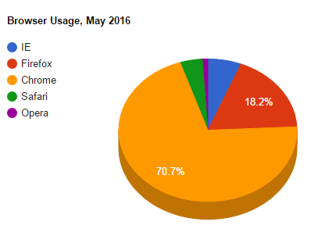
Google Chart API
The chart displays as a vector graphic in your web page
http://liveweave.com/AUBS26

Slide 13
Useful Link
50 Most Useful APIs for Developers:
http://www.computersciencezone.org/50-most-useful-apis-for-developers/

Slide 14
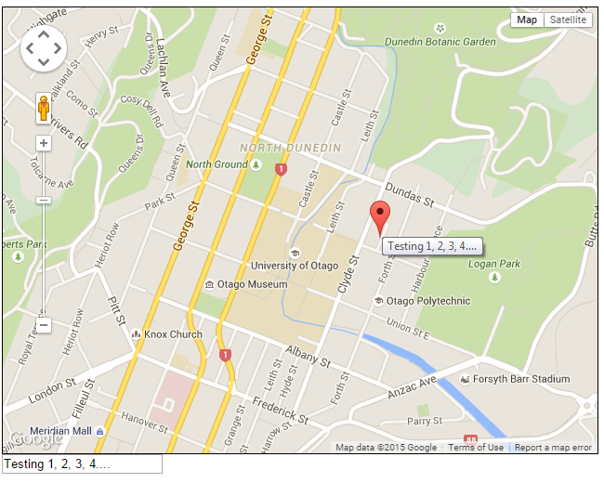
Practical – Google Maps
Lots of useful hints: Google Maps JavaScript API
https://developers.google.com/maps/documentation/javascript/tutorial

